Slide 1







Image steganography
Presentation
by -
k. prakash
vaishnavi
bhagya
charan
sairam
vishwa

Slide 2



what is image steganography
Image steganography is a technique of hiding information or data within an image in such a way that it is imperceptible to the human eye. The goal is to embed data within the image's pixels without causing any noticeable changes in its appearance. This covert method allows for secure communication, data protection, or watermarking, where the hidden information can only be revealed by those with the knowledge of the steganographic key or algorithm

Slide 3


LSB algorithm
It is a common technique to hide data within the least significant bit of each pixel in an image.
It involves altering the pixel color values in an image ,making imperceptiable changes to the image.

Slide 4

image before and after performing steganography
BEFORE
AFTER

Slide 5
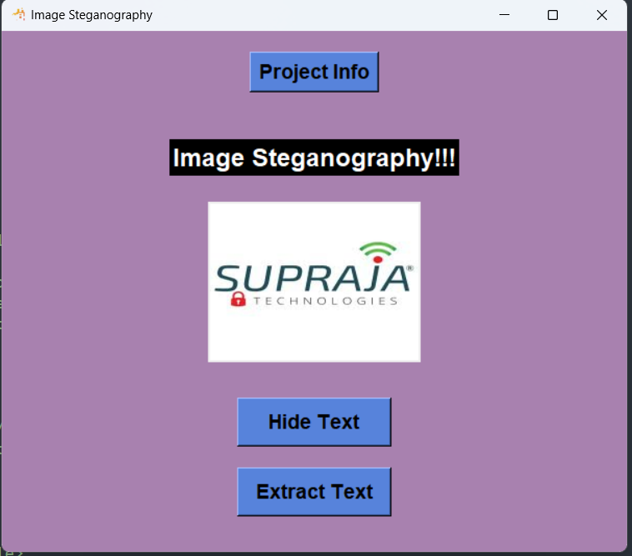


Our application
Hide text is used to hide a text into a image .
the extract text is used to decrypt message from a image.
Project info contains information about the project makers .

Slide 6
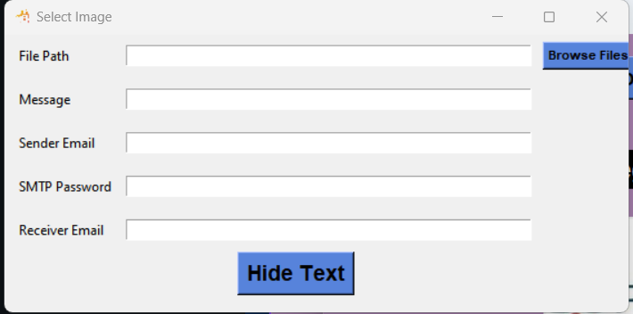
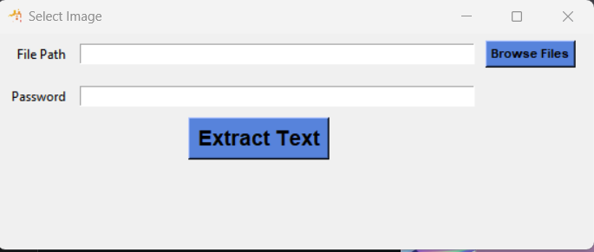
Our application
Extract text window
hhide text window

Slide 7
What we do
Image is taken from our device using the browse file option.
The text we want to hide is entered .
sender and receiver mail is entered .
SMTP password is entered .
On clicking the hide button the text gets encrypted in the image and the encrypted image along with a password is send to the receivers mail.

Slide 8
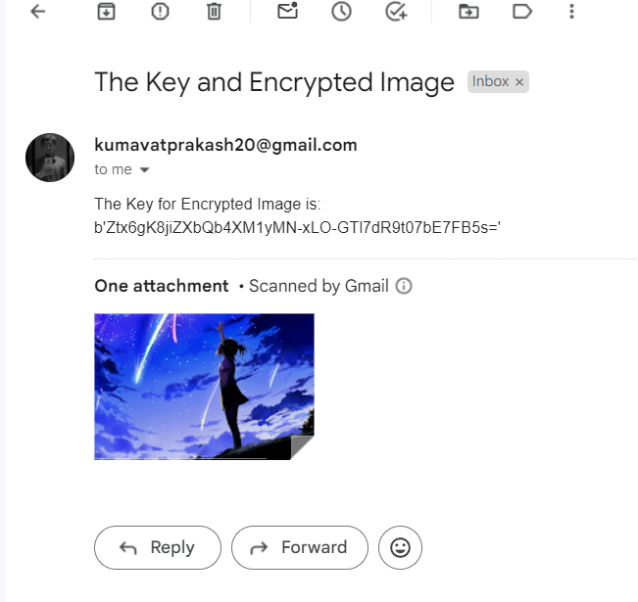
What we do
The receiver receives a mail from the sender which contains key to decrypt the image and the encrypted .
on going to the application and uploading the encrypted image and password we are able to get the text which was hidden in the image.

Slide 9
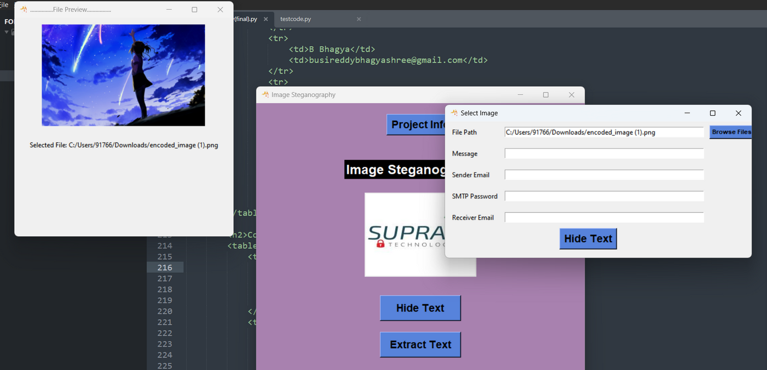
Add on feature
The add on feature for this application is we can view the image we have selected .

Slide 10

Thank You

